Slide 1
PUK: Simulating Cyclic Voltammograms
Marcus Nørgaard Weng, 5. år Nanoscience

Slide 2
Oversigt
Introduction
Reactions
DFT training data
Methods
Predicting binding energies
Predicting energies of simulated surfaces
Surface binding energies to voltammogram
Simulating surface adsorbates while varying voltage
Modeling neighbour-interactions
Modeling hysteresis
Results
Predicting binding energies of adsorbates
Predicting energies of simulated surfaces
Surface binding energies to voltammogram
Simulating surface adsorbates while varying voltage
Conclusion

Slide 3
Oversigt
Introduction
Reactions
DFT training data
Methods
Predicting binding energies
Predicting energies of simulated surfaces
Surface binding energies to voltammogram
Simulating surface adsorbates while varying voltage
Modeling neighbour-interactions
Modeling hysteresis
Results
Predicting binding energies of adsorbates
Predicting energies of simulated surfaces
Surface binding energies to voltammogram
Simulating surface adsorbates while varying voltage
Conclusion

Slide 4
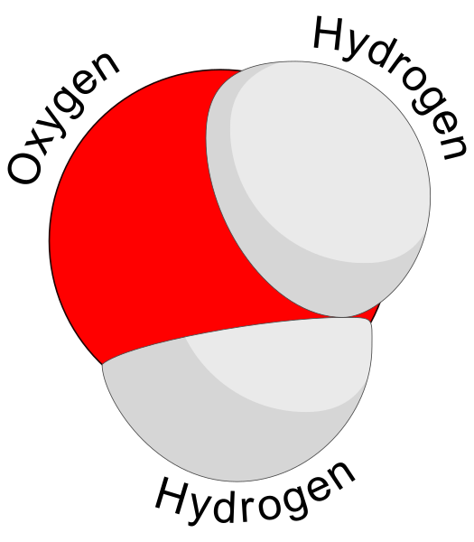
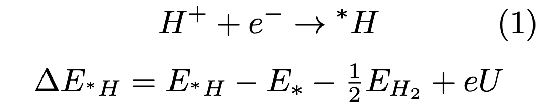
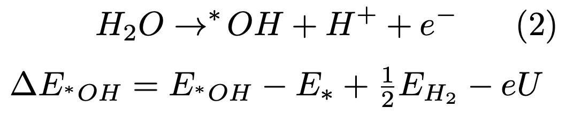
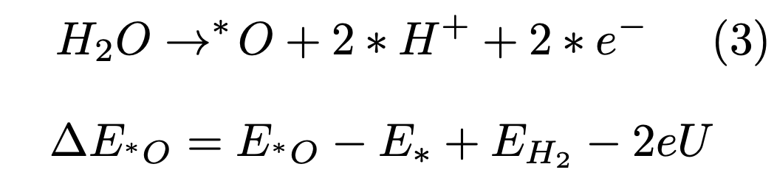
Introduction – Reactions
Motivation:
Find good catalysts for catalysing important chemical processes for eg. fuel cell reactions
System:
Aqueous solution
Reversible Hydrogen Electrode

Slide 5
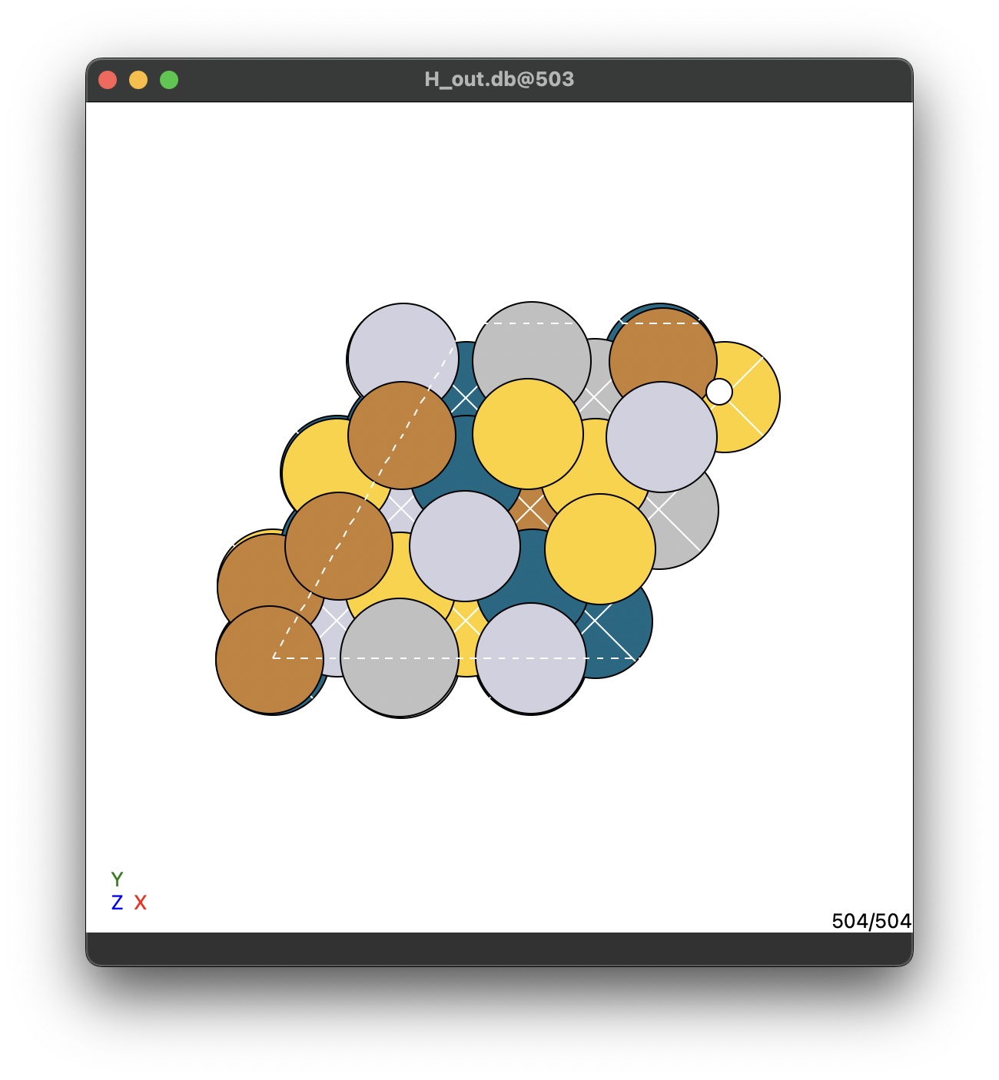
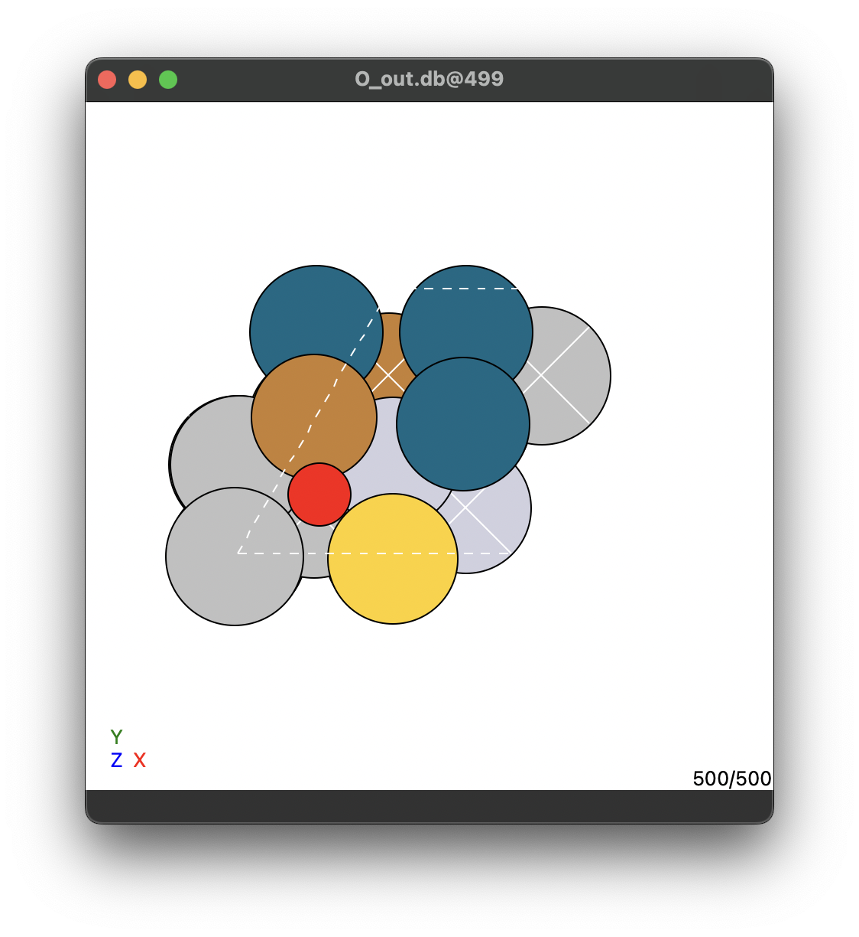
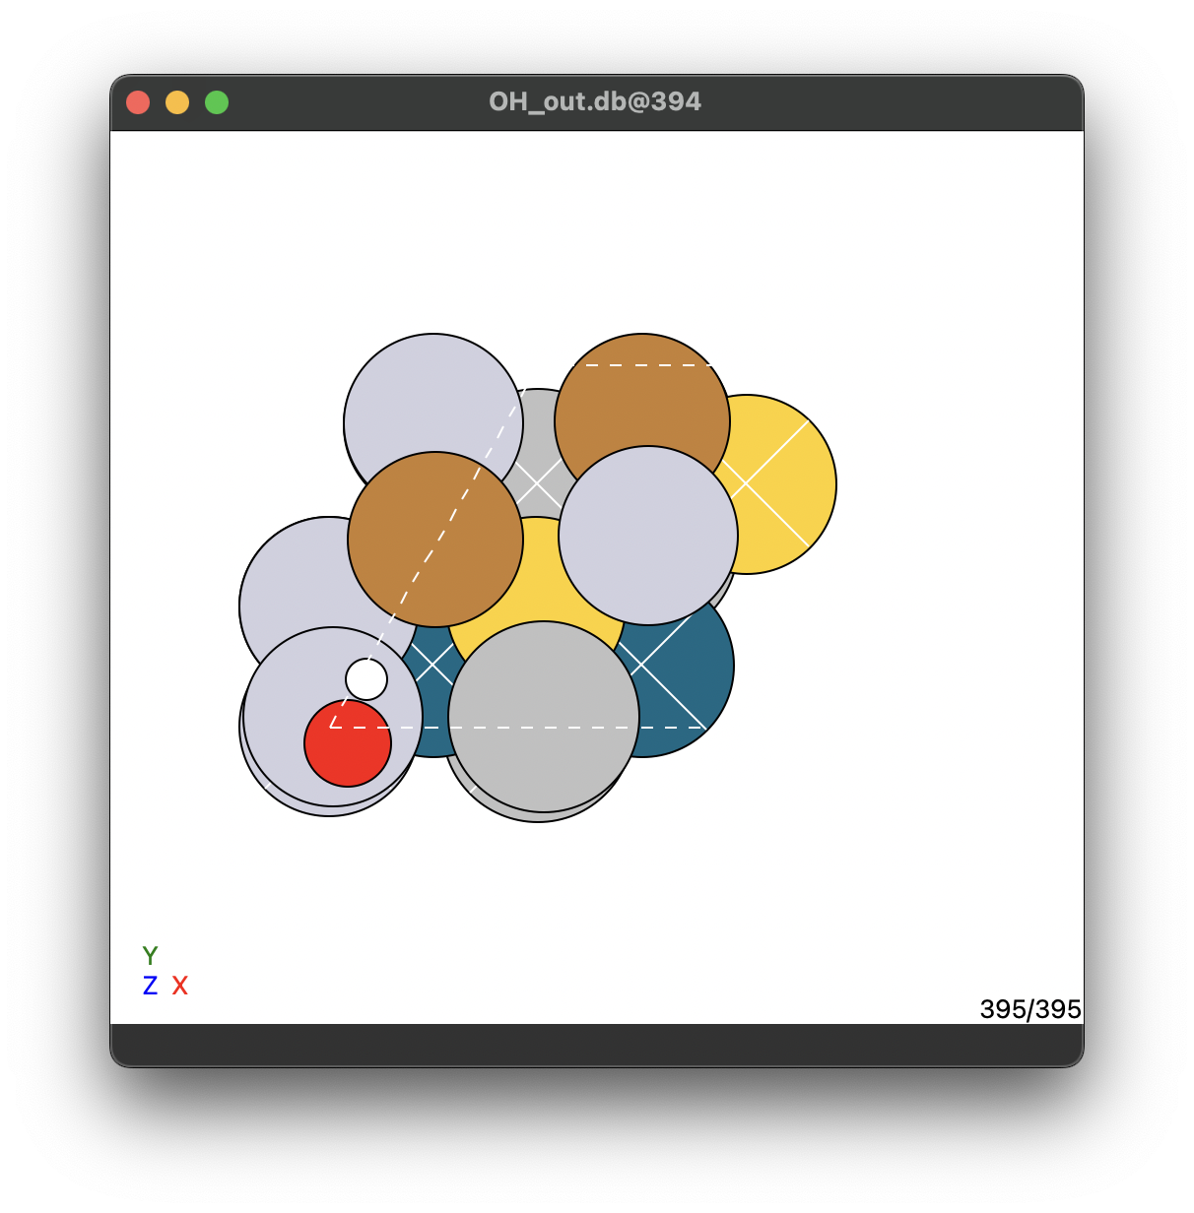
Introduction – DFT data
H_out.db | O_out.db | OH_out.db
56 slabs | 500 slabs | 395 slabs
9 site/slab | 1 site/slab | 1 site/slab
504 total slabs | 500 total slabs | 395 total slabs
* Data fra Jack Kirk Pedersen

Slide 6
Oversigt
Introduction
Reactions
DFT training data
Methods
Predicting binding energies
Predicting energies of simulated surfaces
Surface binding energies to voltammogram
Simulating surface adsorbates while varying voltage
Modeling neighbour-interactions
Modeling hysteresis
Results
Predicting binding energies of adsorbates
Predicting energies of simulated surfaces
Surface binding energies to voltammogram
Simulating surface adsorbates while varying voltage
Conclusion

Slide 7
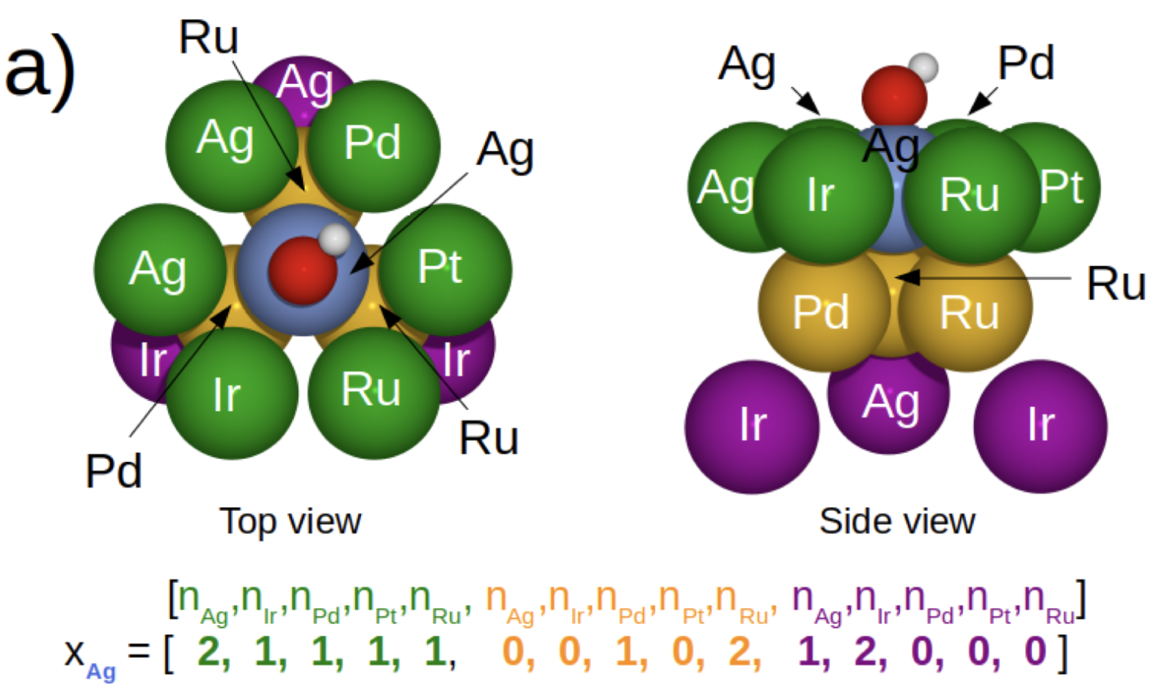
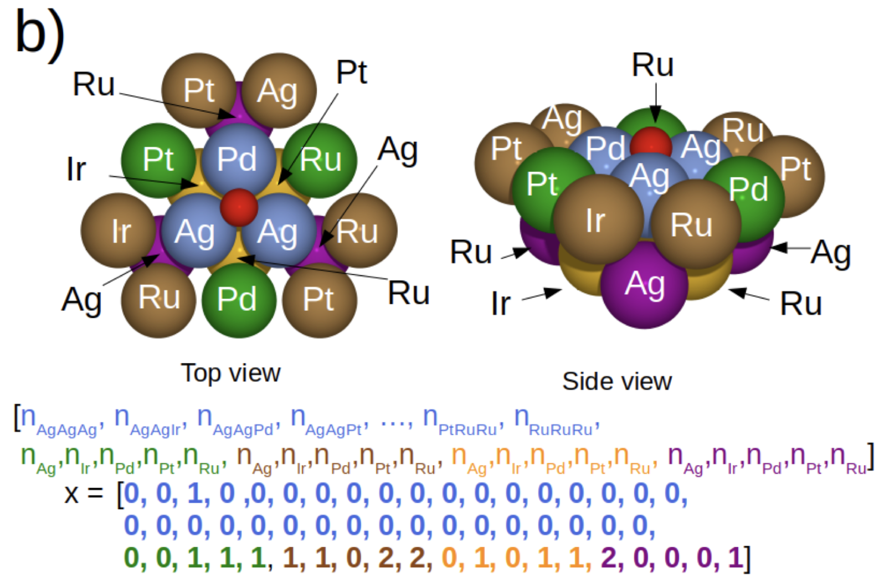
Methods – Predicting binding energies
Label:
Energy
On-top slab
*
Input:
Regression algorithm
Feature vector
Label:
Energy
Hollow-site slab
Input:
Regression algorithm
Feature vector
*Christian M Clausen et al. “What Atomic Positions Determines Re- activity of a Surface? Long-Range, Directional Ligand Effects in Metallic Alloys”. In: Advanced Science 8.9 (2021), p. 2003357.

Slide 8
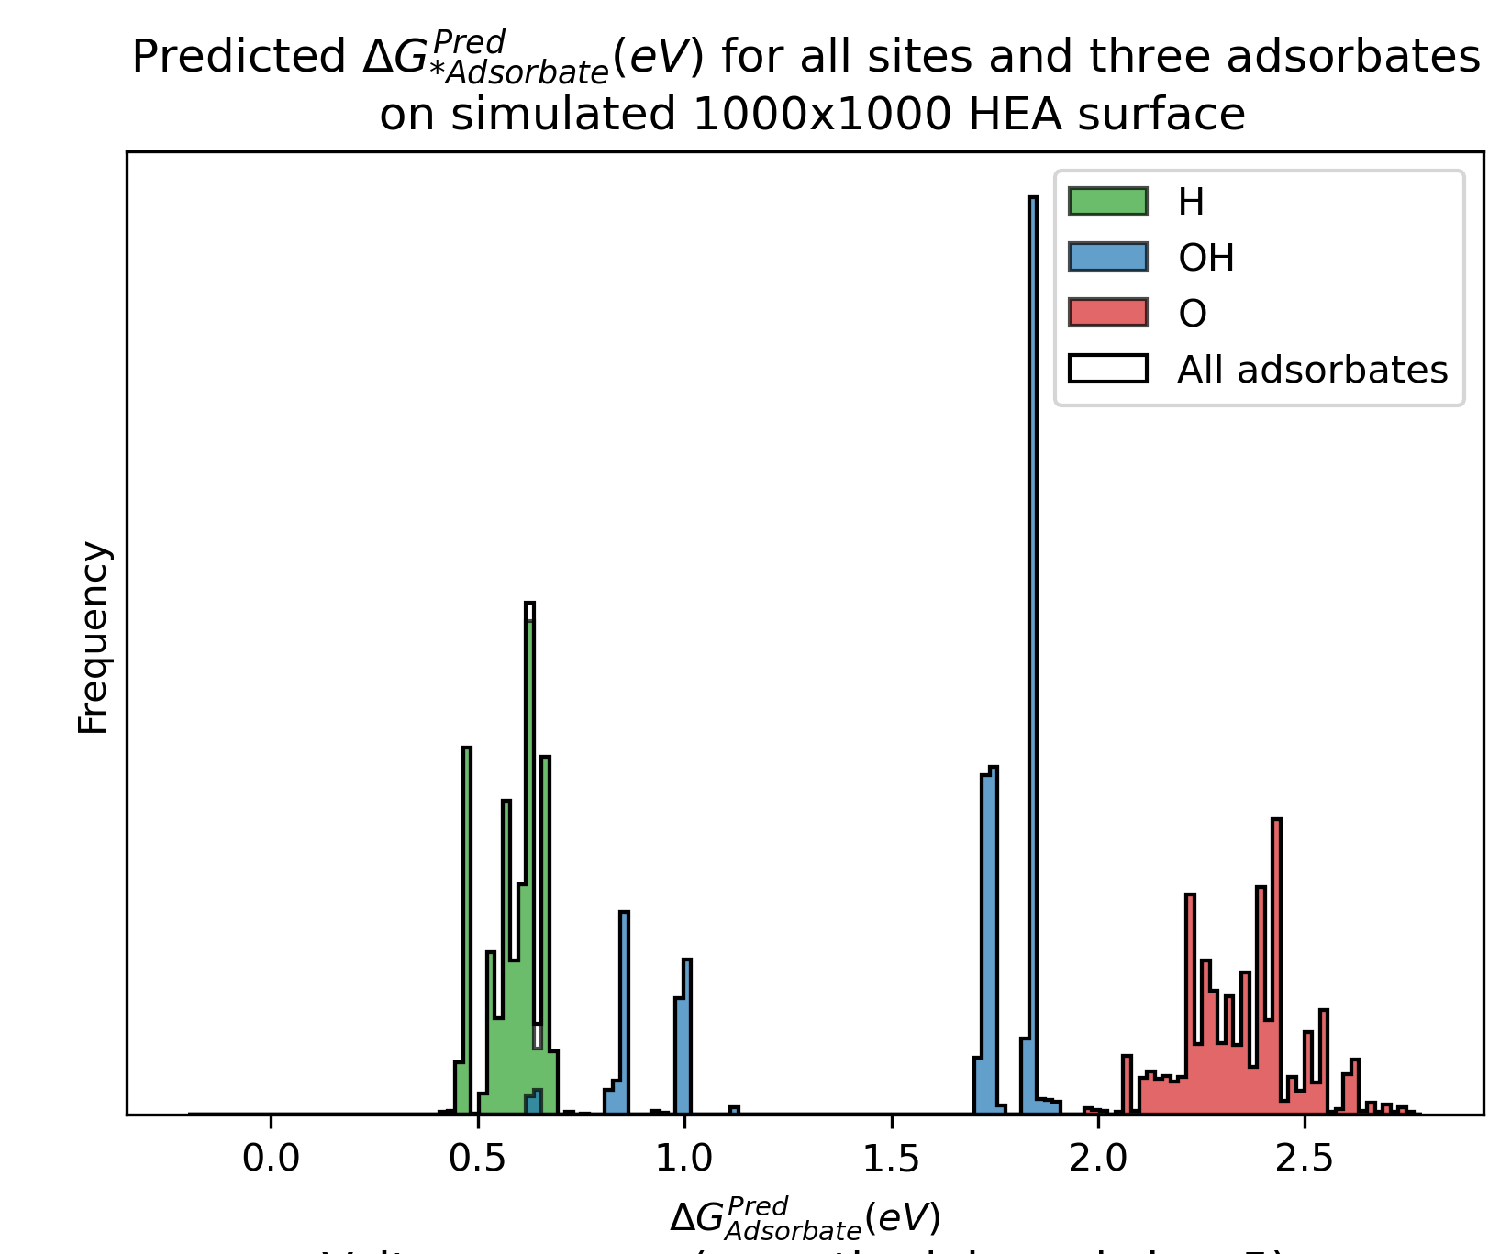

Methods – Predicting energies of simulated surfaces
Simulating surface
[Au, Ag]
1000
[25, 75]
= hollow FCC site
= on-top site
1st layer of surface shown
Predicted energies
Regression algorithm
Feature vectors

Slide 9
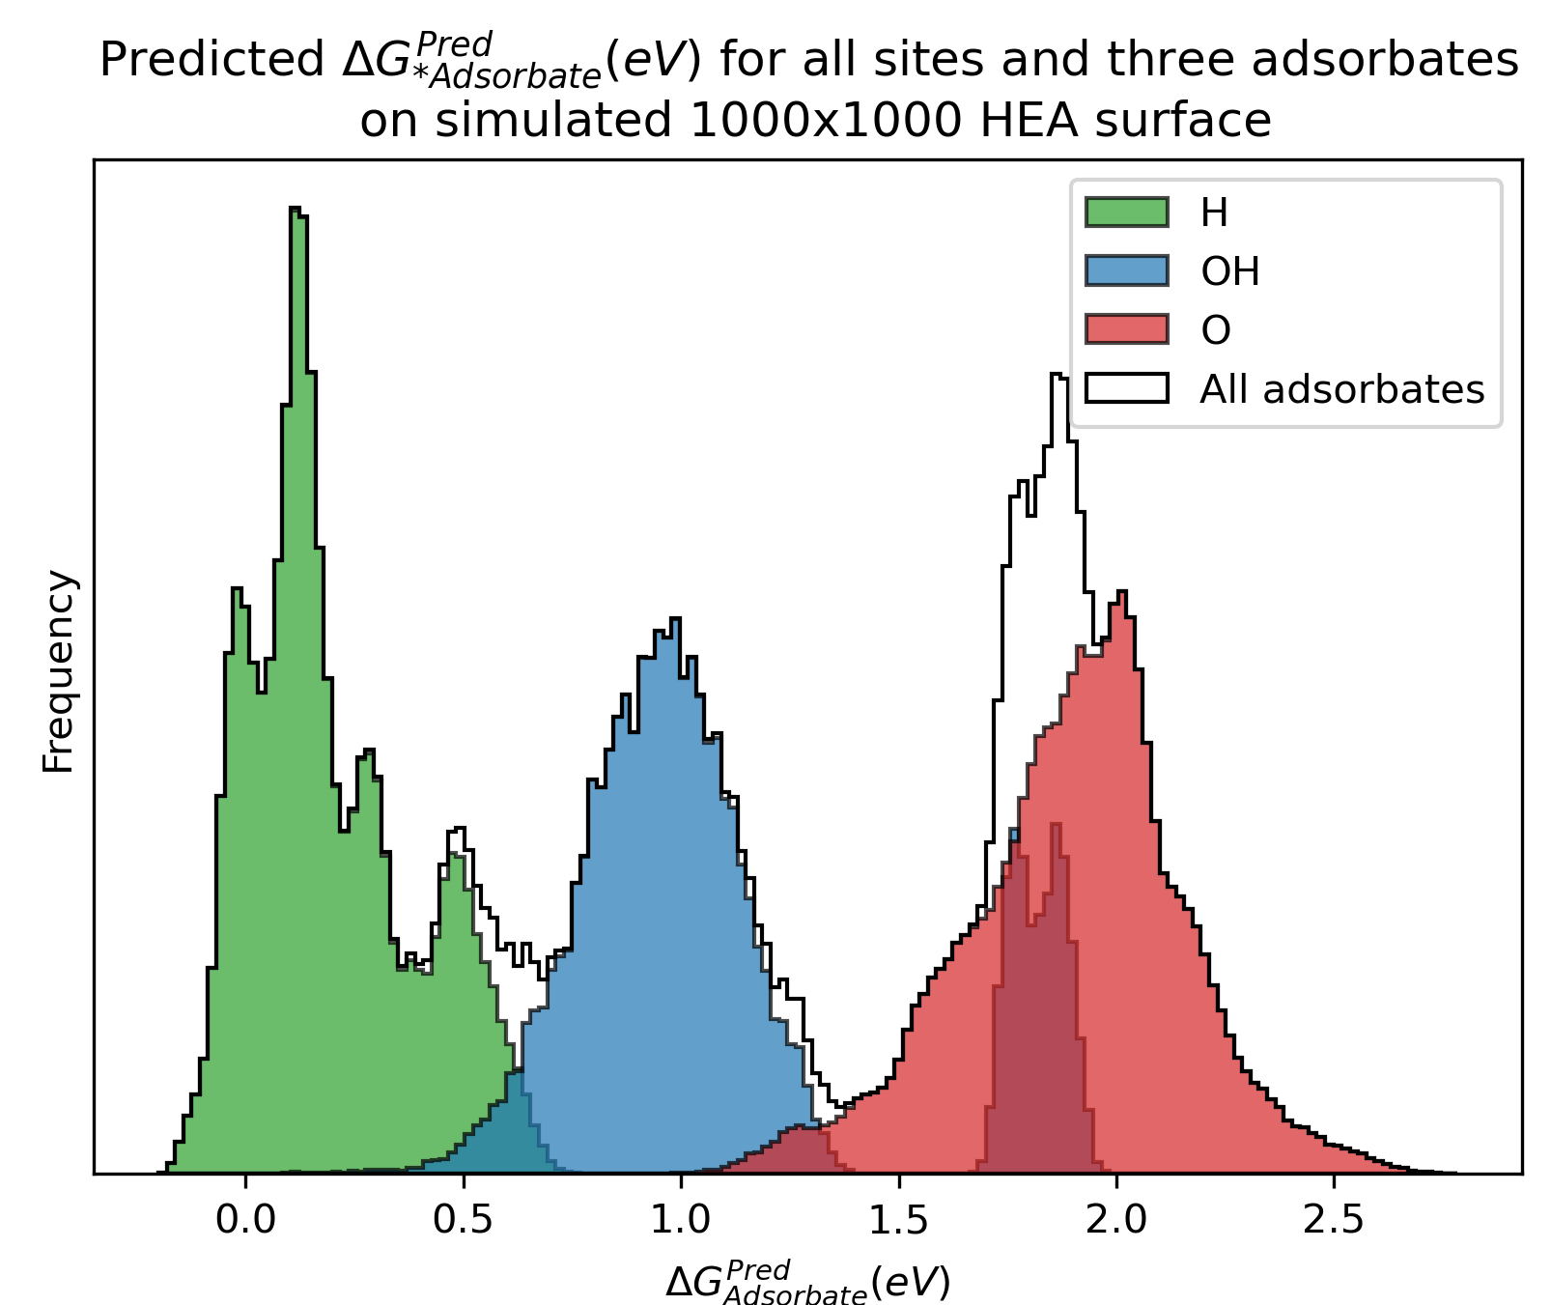
Methods – Predicting energies of simulated surfaces
Simulate surface
Feature vectors
Predict energies
Plotting
Choose:
Metals
Split
Size

Slide 10
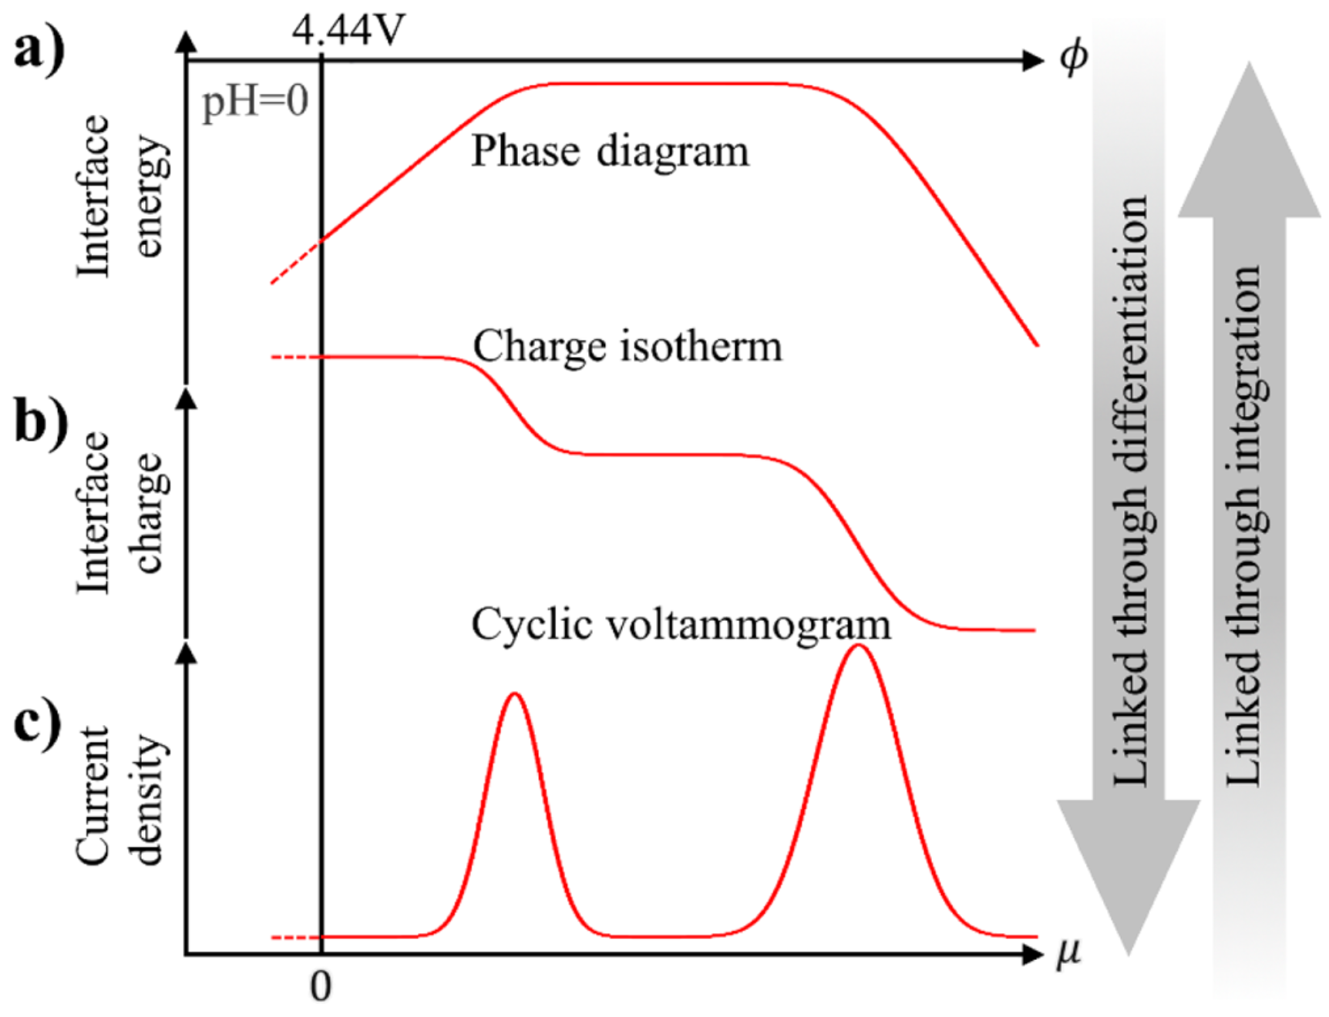
Methods – Surface binding energies to voltammogram
Source: Jan Rossmeisl et al. “Realistic cyclic voltammograms from ab initio simulations in alkaline and acidic electrolytes”. In: The Journal of Physical Chemistry C 124.37 (2020), pp. 20055–20065.

Slide 11
Methods – Surface binding energies to voltammogram
0
Interface energy
Voltage
Source: Jan Rossmeisl et al. “Realistic cyclic voltammograms from ab initio simulations in alkaline and acidic electrolytes”. In: The Journal of Physical Chemistry C 124.37 (2020), pp. 20055–20065.

Slide 12
Methods – Surface binding energies to voltammogram
0
Interface energy
Voltage
1
0
-1
Interface charge
-2
Voltage
Source: Jan Rossmeisl et al. “Realistic cyclic voltammograms from ab initio simulations in alkaline and acidic electrolytes”. In: The Journal of Physical Chemistry C 124.37 (2020), pp. 20055–20065.

Slide 13
Methods – Surface binding energies to voltammogram
1
0
-1
Interface charge
-2
Voltage
Source: Jan Rossmeisl et al. “Realistic cyclic voltammograms from ab initio simulations in alkaline and acidic electrolytes”. In: The Journal of Physical Chemistry C 124.37 (2020), pp. 20055–20065.

Slide 14
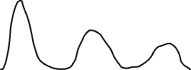
Methods – Surface binding energies to voltammogram
1
0
-1
Interface charge
-2
Voltage
Current density
Voltage
Source: Jan Rossmeisl et al. “Realistic cyclic voltammograms from ab initio simulations in alkaline and acidic electrolytes”. In: The Journal of Physical Chemistry C 124.37 (2020), pp. 20055–20065.

Slide 15
Methods – Surface binding energies to voltammogram
Current density
Voltage
Source: Jan Rossmeisl et al. “Realistic cyclic voltammograms from ab initio simulations in alkaline and acidic electrolytes”. In: The Journal of Physical Chemistry C 124.37 (2020), pp. 20055–20065.

Slide 16
Methods – Simulating surface adsorbates while varying voltage
Things not modelled in the previous method:
Circular voltage sweep
Ability to model effects
Hysteresis
Neighbour-interactions
Voltage
Circular sweep
Notes:
The previous cyclic voltammogram method does not account for effects seen in experimental data, such as hys- teresis and neighbour interactions. A second method where these effects are approximated is used. In this sec- ond method a linear sweep or circular sweep in voltage made, while concur- rently keeping track of the adsorbates on the surface and the summed bid- ing energies (∆G) of the adsorbates at each voltage.

Slide 17
Methods – Simulating surface adsorbates while varying voltage
Algorithm
Predict all energies on all sites
All three adsorbates
For voltage in voltage range:
Loop through all adsorbates:
Account for steric hindrance, if neighbours
If binding energy > Hysteresis energy barrier: Remove
Loop through the smallest energies:
Check for emptiness on the site
Account for steric hindrance, if neighbours
If binding energy < 0: Adsorb
Continue adsorbing until lowest energy > 0
Save the summed binding energies of all adsorbates divided by total number of atoms
Voltage
Circular sweep
Notes:
The previous cyclic voltammogram method does not account for effects seen in experimental data, such as hys- teresis and neighbour interactions. A second method where these effects are approximated is used. In this sec- ond method a linear sweep or circular sweep in voltage made, while concur- rently keeping track of the adsorbates on the surface and the summed bid- ing energies (∆G) of the adsorbates at each voltage.

Slide 18
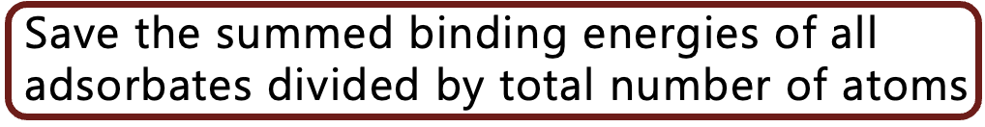



Methods – Simulating surface adsorbates while varying voltage
Phase diagram
0
Interface energy
Voltage

Slide 19
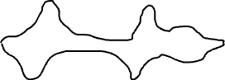
Methods – Simulating surface adsorbates while varying voltage
Phase diagram
0
Interface energy
Voltage
Double differentiation
Circular voltammogram
0
Current density
Voltage

Slide 20
Methods – Modelling hysteresis and steric hindrance
Hysteresis
Phenomenon
Model

Slide 21
Results
Introduction
Methods
Results
Conclusion

Slide 22
Conclusion
Introduction
Methods
Results
Conclusion

